Slide 1
ABC Fraud Detection
Ranon Sim, Data Scientist at NCS

Slide 2
Agenda
Problem Overview & Objective
Fraud detection Machine Learning model
Short-term & Long-term Roadmap
Discuss the business resources required

Slide 3
Project Stakeholders
User
Delivery Team
Other Teams
Data Scientists (Omar & Alex)
Product Manager (Ranon)
Regional Operations Team (led by Jamie)
Data Scientists (Omar & Alex)
Product Manager (Ranon)
Business Analysts
System Engineers
Data Engineers
Business Analysts
System Engineers
Data Engineers

Slide 4
Overview
Problem: Fraudsters are abusing and undermining our system for their own benefit. This is hurting not only our financials but our user experiences
Objective: Detect fraudulent behaviour in order to reduce the number of fraud cases on our platform
Goals:
Design a framework for fraud detection that includes a machine-learning (ML) based solution
Build a working fraud detection ML model that can deliver value for the regional operations team

Slide 5
Fraud Management

Slide 6
Fraud Management Solutions
Fraud Management
Fraud Analysis
Fraud Detection
Decision Support
* Focus of this project

Slide 7
Types of Fraud (Non-Exhaustive)
Types of Fraud
GPS Spoofing
Incentive Abuse
Surge-Price Manipulation
Fake Account Creation
Fraud Scope: Detection of fake accounts created by fraudsters for various illicit activities e.g. offering ride services in the black market or abusing the performance incentive systems.

Slide 8
Fraud Detection Workflow
Provide the signals for fraudulent behavior
Signals get distilled into hand-engineered features
ML Models are fine-tuned to maximize precision and recall
Data from various sources
Engineer Features
Build Machine Learning Models
Deep Learning Models
Labelling is done here for classification prediction
Production Ready Model outputs
Decision Making
Rules Engine
Hard-coded Rules
Independent of Feature Engineering
Events can be triggered manually or by the system to weed out fraudulent users
If {this} then do {action}
Hard-coded rules created by analysts are also fed into the rules engine

Slide 9
Machine Learning Model Overview

Slide 10
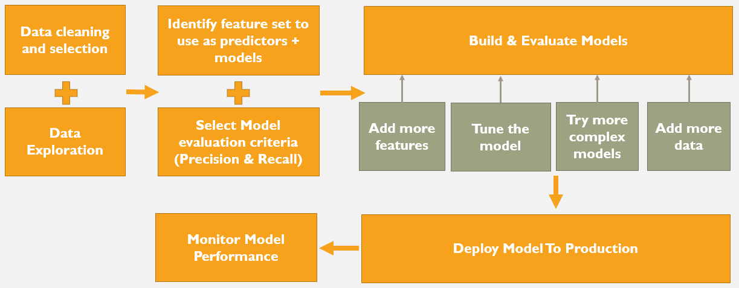
Overview
Objective: Make use of features generated from signals indicating odd behaviour to identify fake accounts created by fraudsters.
Model Building Pipeline:

Slide 11
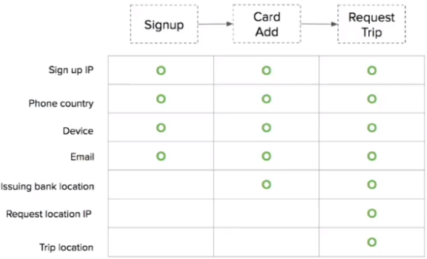
Data Features (used to determine a fake account)
A rich dataset collected at different stages of the user’s life cycle
User Event Data
Examples of user event data that can be used as features
Sign up Information
Behavior Sequences
Time-Series Features
e.g. recurring pattern of cancellations / non-completion rates of rides, contact rate between a user and a driver
e.g. ride occurrences and costs

Slide 12


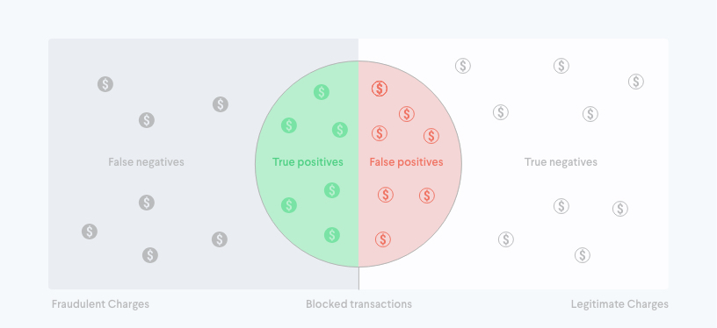
Model Evaluation Criteria
A balance between high precision and recall will be used for evaluating the model
True positives (how many fraudsters we block)
False positives (how many good people we block)
False negatives (how many fraudsters we allow)

Slide 13

Short-Term Road map

Slide 14
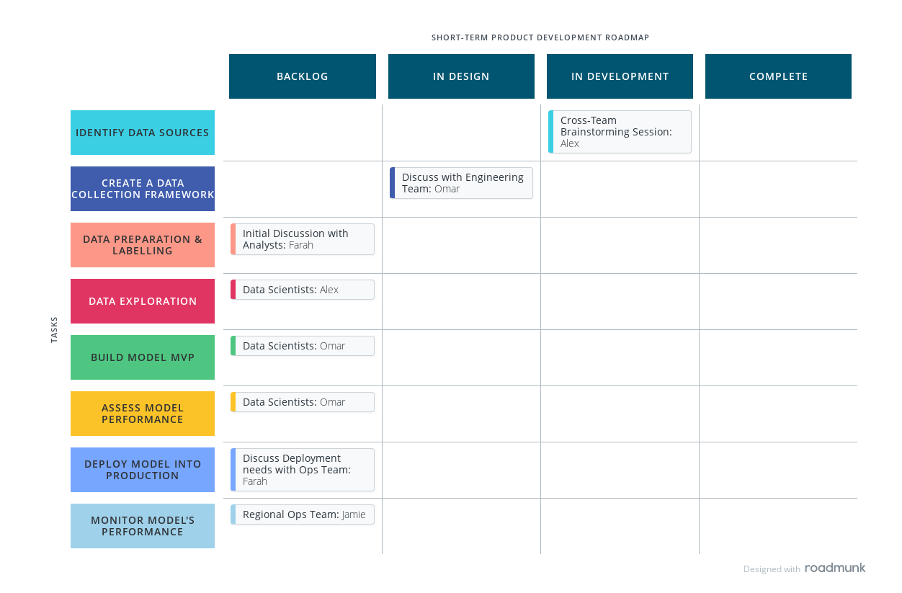

Slide 15
Short-Term Success Metrics
Functionality :
Output of Model must be able to explain why an account is fake and facilitate decision making
Performance:
version 1.0 of model must be able to achieve at least 0.7 recall (TP / (TP + FN) ) or identify 70% of the total number of fraudulent cases (from the validation dataset)
Application must be able to generate results within X minutes / Y hours (to be discussed with the regional operations department)
Usability:
Model should not be a black-box i.e. the reasons for a fraud occurring should be interpretable.
False positive cannot exceed 50% (measured using precision ) and impact non-fraudulent users’ experience
Data scientists should be able to provide the necessary information for the operations team to identify, monitor and take action on scammers/suspects.

Slide 16
Long-Term Road map

Slide 17
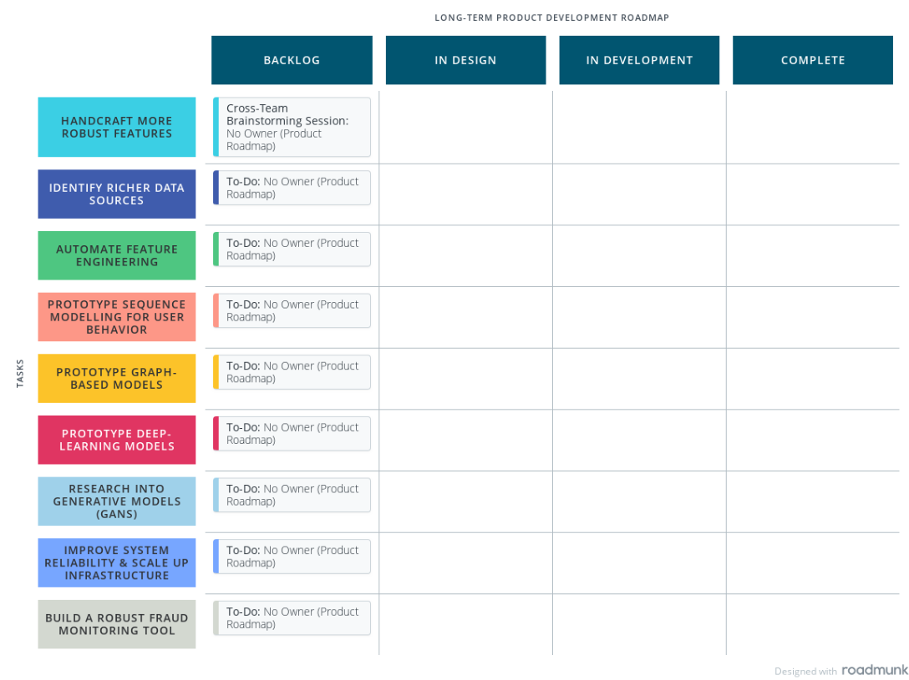

Slide 18
Long-Term Success Metrics
Functionality :
Models are able to handle much more complicated features
Models rely less on hard-coded features but can identify new user behavior on their own
Models can learn good user behavior to detect when someone is deviating from it
Performance:
Application have high precision and recall (above 0.9)
Decision making time must be reduced to a matter of seconds or sub-seconds
Usability:
Monitoring tool (dashboard form) should contain all the necessary information for the operations team to identify, monitor and take action on scammers/suspects.

Slide 19
Key Components for Smooth Operationalization

Slide 20
Critical Components
Data: Quality data is foundational to building anti-fraud ML systems. Data sets are only growing larger, and as the volumes increase, so does the challenge of detecting fraud. Thankfully the adage that more data equals better models is true when it comes to fraud detection. The make-or-break factor is having a ML platform that can scale as data and complexity increase.
Multiplicity: There’s no single ML algorithm or method that works best for fraud detection. Success comes from the ability to try lots of different methods, testing variations and evaluating them with an array of data sets. That requires a toolkit with a variety of supervised and unsupervised methods, as well as a range of feature engineering techniques.
Integration: Once you have developed a ML model, the challenge becomes deploying it in an operational run-time environment. If your data is in Hadoop, it makes sense that your ML model can be applied in Hadoop. Similarly, if your data is streaming in real-time systems, you want a ML engine that can run in real time or in stream

Slide 21
Critical Components
Model Interpretability: ML methods and models are generally black boxes. Explaining the “what” and the “how” for ML systems is critical.
Ongoing monitoring: As populations and the underlying data shift, system inputs are expected to degrade and affect overall performance. A good monitoring program registers and tracks the ongoing efficacy of all models.
Experimentation: Successful ML programs have an element of ongoing experimentation. It isn’t enough to just build a ML model and let it crunch. Fraudsters are clever, and technology changes quickly. Having a sandbox where our data scientists can freely experiment with a variety of methods, data and techniques to combat fraud is a critical aspect of top anti-fraud programs.

Slide 22
Business Requirements

Slide 23
Resources Required from business team(s)
Required Stakeholders
Objective
People from the business, finance, economics, risk management and operations teams
Provide knowledge on how fraudulent activities have occurred/are occurring
e.g. The operations team can share what they learnt from the manual study of fraudulent user accounts e.g. from user reviews and ratings / behavioral patterns
Help identify unique business functionalities and policies in our ride-hailing application that leave us susceptible to exploitation
Provide a diverse set of data sources from which behavioural patterns can be captured

Slide 24
Assumptions

Slide 25
Assumptions
Data: How we expect the data to be formatted, what features are available to us, how global in scope the data is, the applicability of a certain feature to act as a proxy for something, etc.
Models: All Machine Learning models come with their own assumptions. For example, an assumption that our model can force on us is no NULL values, which may require us to include an imputation step in our tasks plan. These assumptions and any violation of the assumptions are important to log to make sure we fully understand the pros and cons of using any mode.
Workflow or Data Pipeline: For example, we might assume that geographical location is available only as a categorical city/state, but our data pipeline might change to pick up latitude/longitude data in the future—and cause us to adjust our model in production.

Slide 26
Risks

Slide 27
Potential Risks
Underestimating the potential work
Inaccurate identification of the task priorities and project benefits
Unable to get hold of relevant stakeholders to discuss important components of the project

